Slide 1
The Role of the QA in Agile
Responsibilities and best practices
SoftUni Team
Technical Trainers
Software University
http://softuni.bg

Slide 2
Table of Contents
Understanding the Agile Methodology
QA – main activities and responsibilities
Agile testing – definition
Agile testing strategy
Key tasks every QA should perform
Risks and problems

Slide 3
#Agile-QA
Sli.do.com

Slide 4
Understanding the Agile Methodology
Agile meaning - able to move quickly and easily
Agile manifesto:
Individuals and interactions over processes and tools
Working software over comprehensive documentation
Customer collaboration over contract negotiation
Responding to change over following a plan

Slide 5
QA main activities and responsibilities
QA Activities & Responsibilities:
Create test documentation and maintain it
Perform manual and automated tests
Identify, isolate and track bugs
Research and Analyze Product features being tested

Slide 6
QA main activities and responsibilities
Formula for top performer:
Get into the details
Proper estimate and prioritization
Stay up-to-date with new testing tools and test strategies
Understand the risk

Slide 7
Agile testing Definition
Agile testing is a software testing practice that follows the principles of agile software development.
Agile testing involves all members of a cross-functional agile team, with special expertise contributed by QAs, to ensure delivering the business value desired by the customer at frequent intervals, working at a
sustainable pace.

Slide 8
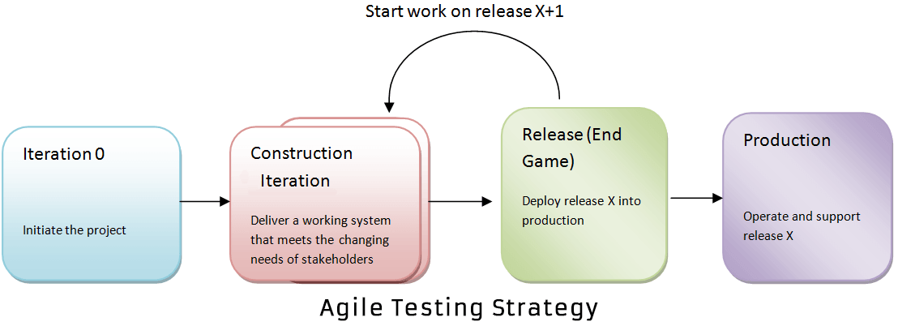
Agile Testing Strategy
Agile testing life cycle spans through four stages:

Slide 9
Key tasks
Help define “DONE”
Scope and estimate
Assess testability
Design and execute test cases
Automate
Collaborate

Slide 10
Key tasks:
7. Verify fixes
8. Attend daily stand-up meetings
9. Track different metrics
10. Fail
11. Embrace change
12. Learn

Slide 11
Risk and problems
Chances of errors are more in Agile
Compressed test execution cycles
Less time to plan
Requirement changes
Automation tests are not replacing the manual check
Productivity metrics can be misleading

Slide 12
Summary
…
…
…
Agile testing involves testing as early as possible in software development life cycle. It demands high customer involvement and testing code as soon as it becomes available. The code should be stable enough to take it to system testing. Extensive regression testing can be done to make sure that the bugs are fixed and tested. Mainly, Communication between the teams makes agile testing success!!!

Slide 14
СофтУни диамантени партньори

Slide 15
СофтУни диамантени партньори

Slide 16
Trainings @ Software University (SoftUni)
Software University – High-Quality Education, Profession and Job for Software Developers
softuni.bg
Software University Foundation
http://softuni.foundation/
Software University @ Facebook
facebook.com/SoftwareUniversity
Software University Forums
forum.softuni.bg

