Slide 1
Project Management
Presentation by Slav Karaslavov

Slide 2
About Me
I’m a Project Manager/Product Owner with around 10 years of experience in IT.
Slav Karaslavov
slavkaraslavov@gmail.com

Slide 3
Corporate Overview
Infragistics – The Fastest Path to Amazing Experiences
Established 1989
Microsoft Gold Certified Partner
Google Leverage Partner
Developer Tools in use in 400 of the Fortune 500
1,500,000+ developer tools community members
Global organization with global support footprint

Slide 4
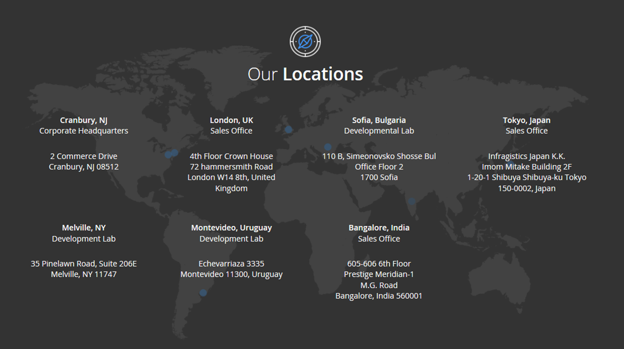

Slide 7
PMP is a standard, PRINCE2 is a methodology and Scrum/Agile is a framework.
In simple terms PMP is a “standard”. Standard means best practices. They are neither legally binding nor you are forced to adopt them. It simply means that based on experiences from all over the world, a standard has been made which if you apply in your situation, will bring favourable results. But it doesn’t mean there is 100% guarantee that they will always bring favourable results to you.

Slide 8
PMP is a standard, PRINCE2 is a methodology and Scrum/Agile is a framework.
Prince2 is a methodology. Methodology means doing something step by step. This is what Prince2 essentially about i.e. it lists down steps to perform to do project management unlike PMP. It tells you what to do first, then second and so on. Although you may see that PMP has also got steps but essentially they are not and neither they are performed in particular order in strict sense.
Here is a quote from Wikipedia.

Slide 9
PMP is a standard, PRINCE2 is a methodology and Scrum/Agile is a framework.
Scrum/Agile is a framework. Framework means a base on which you can build something. That’s why you will see that based on Scrum framework there are numerous certifications being offered. One of them is offered by PMI which is called PMI-ACP (Agile Certified Practitioner). And then there are some others too such as Scrum Alliance and Scrum Council.
Framework provides you with boundary or blueprint of what is included in it and then you can extend on it. All of these certifications above have their own course outline and structure even though they are based on same framework.

Slide 10
What is a Project?
A project is a temporary endeavor undertaken to produce a unique product or service.
TEMPORARY
Definitive beginning and end
UNIQUE
New undertaking, unfamiliar ground
Project characteristics

Slide 11
How the customer explained it
How the Project Manager understood it
How the Analyst designed it
How the Programmer wrote it
How the Business Consultant described it
How the project was documented
What operations installed
How the customer was billed
How it was supported
What the customer really needed

Slide 12
Project Success
CUSTOMER REQUIREMENTS SATISFIED/EXCEEDED
COMPLETED WITHIN ALLOCATED TIME FRAME
COMPLETED WITHIN ALLOCATED BUDGET
ACCEPTED BY THE CUSTOMER

Slide 13
Project Failure
SCOPE CREEP
POOR REQUIREMENTS GATHERING
UNREALISTIC PLANNING AND SCHEDULING
LACK OF RESOURCES

Slide 14
What is Project Management
Project Management is the application of skills, knowledge, tools and techniques to meet the needs and expectations of stakeholders for a project.
The purpose of project management is prediction and prevention, NOT recognition and reaction

Slide 15
Key Areas of Project Management
Scope Management
Issue Management
Cost Management
Quality Management
Communications Management
Risk Management
Change Control Management

Slide 16
Role of a Project Manager
PROCESS RESPONSIBILITIES
Project issues
Disseminating project information
Mitigating project risk
Quality
Managing scope
Metrics
Managing the overall work plan
PEOPLE RESPONSIBILITIES
Implementing standard processes
Establishing leadership skills
Setting expectations
Team building
Communicator skills

Slide 17
Triple Constraint
TIME
QUALITY
COST
SCOPE

Slide 18
Triple Constraint
Increased Scope = increased time + increased cost
Tight Time = increased costs + reduced scope
Tight Budget = increased time + reduced scope.

Slide 19
Scope Management
Primarily it is the definition and control of what
IS and IS NOT included in the project.

Slide 20
Issue Management
Issues are restraints to accomplishing the deliverables of the project.
Typically identified throughout the project and logged and tracked through resolution.
Issue? Already impacting the cost, time or quality.

Slide 21
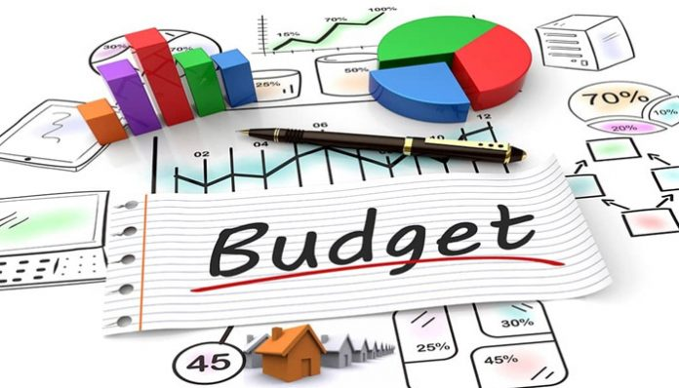
Cost Management
This process is required to ensure the project is completed within the approved budget and includes:
RESOURCES (people, equipment, materials)
QUANTITIES
BUDGET

Slide 22
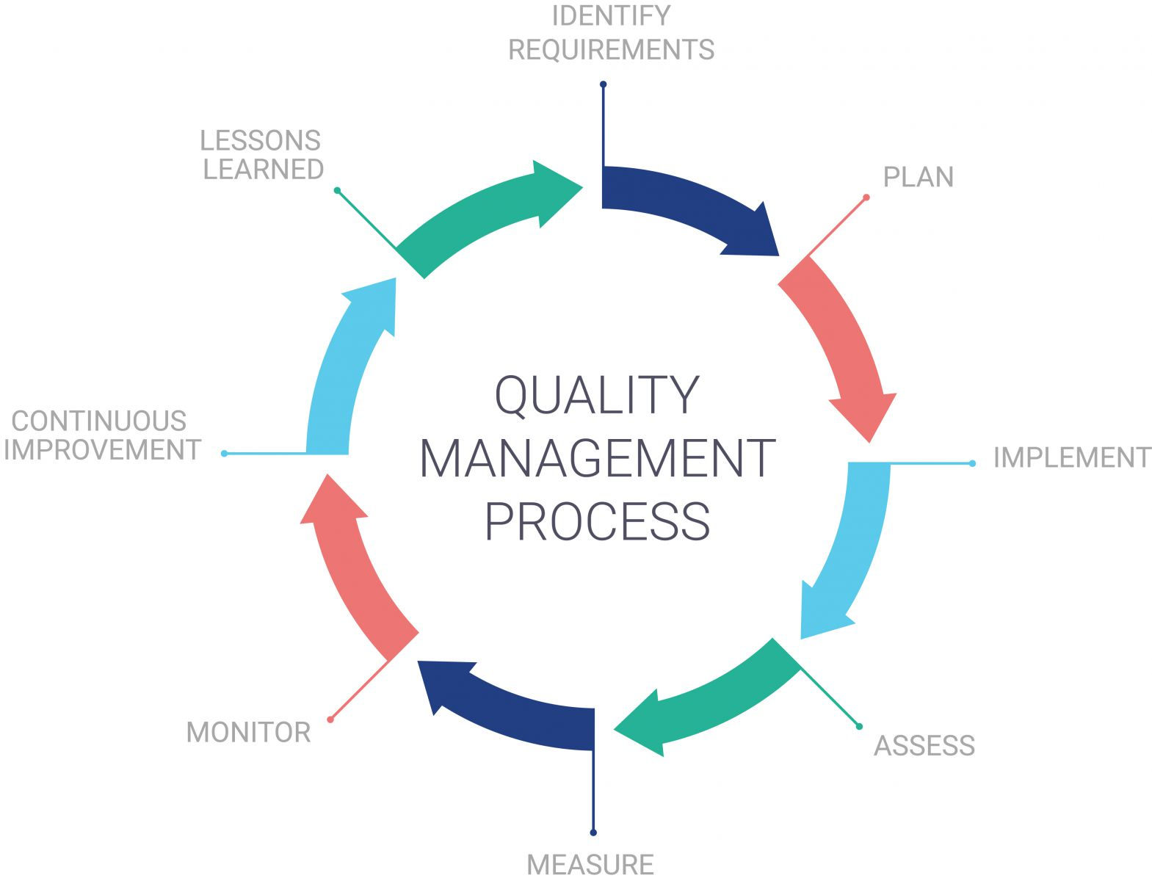
Quality Management
Quality Management is the process that insure the project will meet the needs.

Slide 23
Communication Management
This process is necessary to ensure timely and appropriate generation, collection, dissemination, and storage of project information.
Involving all Stakeholders in the communication
for the Project.

Slide 24
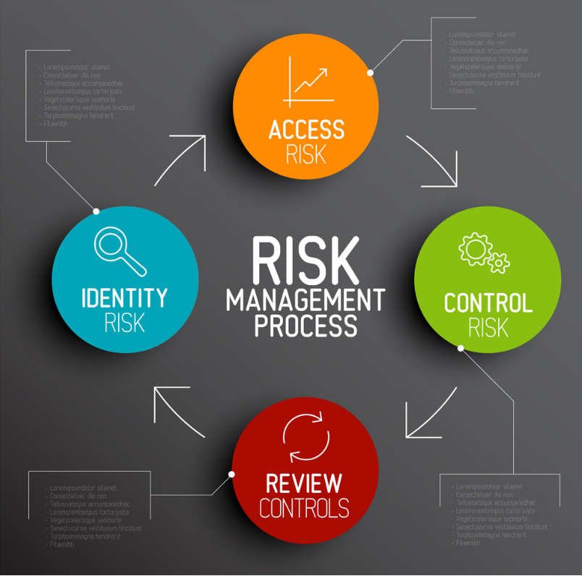
Risk Management
Risk identification and mitigation strategy
Risk update and tracking
Risk? POTENTIAL negative impact to project

Slide 25
Change Control management
Define how changes to the project scope will be executed
SCOPE CHANGE
SCHEDULE CHANGES
SCHEDULE CHANGES

Slide 26
Project Life Cycle
INITIATION PHASE
DEFINITION PHASE
PLANNING PHASE
IMPLEMEN- TATION PHASE
DEPLOYMENT PHASE
CLOSING PHASE

Slide 27
Initiation Phase
Define the need
Return on Investment Analysis
Make or Buy Decision
Budget Development

Slide 28
Definition Phase
Determine goals, scope and project constraints
Identify members and their roles
Define communication channels, methods, frequency and content
Risk management planning

Slide 29
Planning Phase
Resource Planning
Work Breakdown Structure
Project Schedule Development
Quality Assurance Plan

Slide 30
Implementation Phase
Task Management
Issue Management
Financial Management
Time Management
Test Management
Stockholder Management

Slide 31
Deployment Phase
User Training
Production Review
Start Using

Slide 32
Closing Phase
Contractual Closeout
Post Production Transition
Lessons Learned

Slide 33
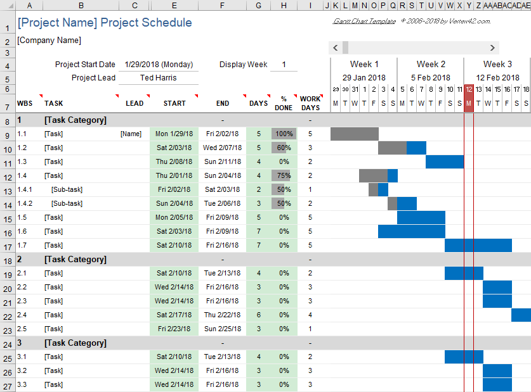
Gantt Chart

Slide 34
Project Management Tools

